Slide 1
Cross Selling
Solve One More

Slide 2
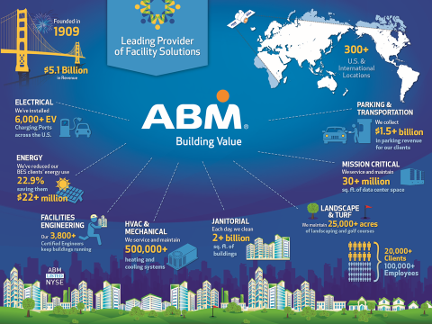
Notes:
Welcome and Introductions (10 minutes)
SAY:
Welcome to the Solve One More commitment to Cross Selling kick off meeting.
Our vision at ABM is “to be the clear choice in the industries we serve through engaged people”. One way to achieve this vision is to become the single-source provider of all types of facility solutions for our clients. However, a majority of our clients are not aware of the incredible breadth of services we can deliver in industries we serve. To overcome this lack of awareness and to focus on “Making a difference, every person, every day” for clients, employees will have the simple goal of trying to “Solve One More” problem for our clients by leveraging the services and solutions that ABM provides within their current Industry Group or across to another Industry Group through Cross Selling efforts. To encourage participation, we developed an incentive program, which rewards employees who have a conversation with a client or prospect about a facility problem that ultimately results in additional business with ABM.
What we expect to accomplish today is:
Understand the services ABM offers in our market
Ensure understanding of the Solve One More process and procedures
Identify clients that may benefit from additional services and what to say to them
Create and execute a plan to generate and close opportunities for additional services
Our agenda includes (read through Meeting Agenda).
Let’s go around the room and give a brief introduction – your name, your industry group and service line, and your role (what you do).

Slide 3
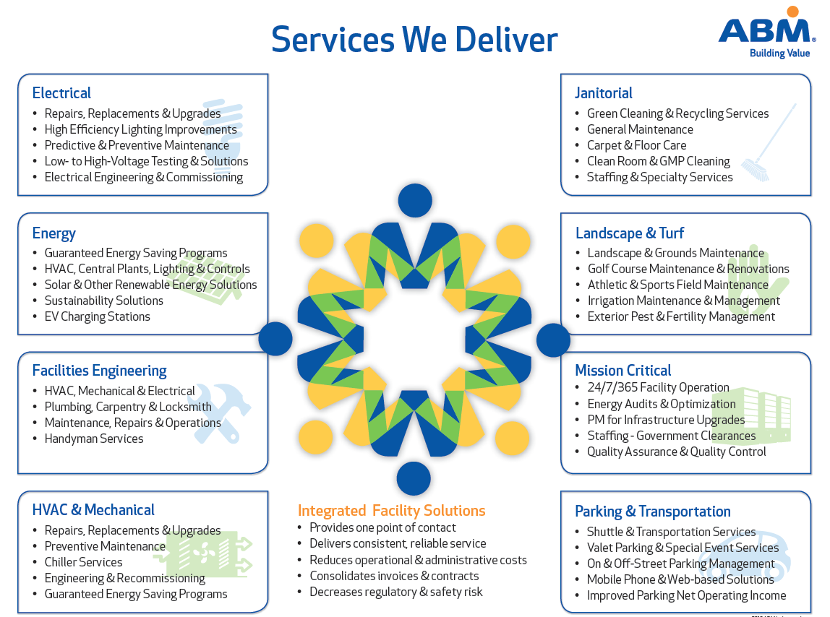
How ABM Cross Sells
Cross Selling Definition
Adding an additional contracted service to a current client in the same Industry Group or across another Industry Group.
Notes:
What is ABM’s Cross Selling Program?

Slide 4
3 Way to Cross Sell
Account Plans
Solve One More version 2.0
Targeted Campaigns
Notes:
Account Plans – Leverage and track opportunities added to the accounts that have a high Growth Potential Score on the Account Plan. Building common terminology, definitions, and Success Teams to sell a minimum of $10M in opportunities through the Account Planning Process.
Solve One More 2.0 – The Solve One More program produce $72M in over the past 4 years. The team determined that by leveraging and enhancing the tools built for the SOM program we could drive a minimum of $5M in cross sold revenue in FY18. This is available to all ABM Field Personnel that may not be part of the account planning process and can still identify Opportunities.
3. Targeted Campaigns – This program will focus on a specific group of clients where we are driving to sell a specific service. An example of this type of campaign is selling our Building Energy Solutions into our Custodial clients in the Education Industry Group. We can also use this method and support in a specific branch that is in need of revenue in order to make plan.

Slide 5
Solve One More – Process Review
Notes:
Solve One More Process Review (10 minutes)
SAY:
The meeting invitations included some pre-work. Specifically, you were asked to read the Solve One More Guideline document. Let’s find out what you learned.

Slide 6
Which of the following examples of “cross selling” are eligible for the SOM incentive?
Adding “Engineering” to a current client using our “Janitorial” services
Adding “Lighting” to a current client using our “Parking” services
Adding “Carpet Cleaning” to a current client using our “Janitorial” services
Both A & B
Notes:
Read the question and all answers out loud to the group.
ASK - “Raise your hand if you think the answer is “A”, and repeat for each answer option.
Reveal the answer is “D”
SAY:
Eligible Opportunities for cross selling include contracted services within your Industry Group or outside your Industry Group for an existing client

Slide 7
All ABM employees are eligible to participate in the Solve One More program
True
False
Notes:
Read questions and answers out loud.
Reveal that the answer is TRUE
SAY:
All employees can participate and most employees are eligible for the incentive rewards.
Monetary awards are available to everyone except:
Employees in leadership roles – EVP, SVP, VP, etc.
Employees whose primary job function is to sell multi-service solutions (i.e. Integrated Facility Solutions)
Employees in a position to award work as part of a subcontracting relationship
This is to protect the integrity of their position.

Slide 8
For an Opportunity to be eligible for the incentive reward, it must be…
Entered at abm.com/sellabm or called into 1-855- SolveABM
Reviewed by Inside Sales
Assigned to a Salesperson
Entered prior to contract/job being awarded
Open less than one year
All of the above
Notes:
Read question and answers
ASK: “Who thinks the answer is “F” all of the above?” Reveal that they are correct!

Slide 9
The incentive award paid for qualified Opportunities resulting in a sale is 1.0% of the first year’s contracted value or the Project/TAG value, maximum award of $5,000.00
True
False
Notes:
Read the question and answers.
Reveal that the answer is TRUE.
Ask someone with their smartphone calculate handy, what the incentive pay would be on a $190,000 project? (answer $1,900) what is the incentive pay on a $1.5 million dollar service contract? (answer: $5,000.00 max pay out)

Slide 10
Which is the first step in the Solve One More process?
Enter the Opportunities at abm.com/sellabm or call 1-855-SolveABM.
Inside Sales Team reviews the Opportunity and assigns to the appropriate sales asset.
Salesperson follows up and client signs agreement to have ABM provide additional service.
Employee that provided the Opportunity receives $$$ and recognition
Talk with clients & others about potential facility problems.
Notes:
Read the question and answer out loud.
Ask the group what the right answer is.
Reveal that the right answer is “E” – and the remaining process steps follow in order A thru D
SAY:
A majority of our clients are not aware of the many services we can deliver. “Solve One More” really is just about talking to our clients…but sometimes you need a place to start.
In this next section we will explore what services we offer in our market, how to identify clients that may be in need of them, and what to say to them.

Slide 11
Janitorial Services
Services offered
What’s a Good Lead?
11
Notes:
Identifying Opportunities (20 minutes)
Ask your team to refer to the Cross Selling Sheets in their meeting packet.
For each service, ask someone representing the service line to read the applicable sections of the Cross Selling Sheet.
Ask the group for any additional tips or information that would be helpful for someone trying to start a conversation with their client about this additional service line.

Slide 12
Facilities Engineering
Services offered
What’s a Good Lead?
12
Notes:
Ask your team to refer to the Cross Selling Sheets in their meeting packet.
For each service, ask someone representing the service line to read the applicable sections of the Cross Selling Sheet.
Ask the group for any additional tips or information that would be helpful for someone trying to start a conversation with their client about this additional service line.

Slide 13
Parking & Transportation
Services offered
What’s a Good Lead?
13
Notes:
Ask your team to refer to the Cross Selling Sheets in their meeting packet.
For each service, ask someone representing the service line to read the applicable sections of the Cross Selling Sheet.
Ask the group for any additional tips or information that would be helpful for someone trying to start a conversation with their client about this additional service line.

Slide 14
Energy Solutions
Services offered
What’s a Good Lead?
14
Notes:
Ask your team to refer to the Cross Selling Sheets in their meeting packet.
For each service, ask someone representing the service line to read the applicable sections of the Cross Selling Sheet.
Ask the group for any additional tips or information that would be helpful for someone trying to start a conversation with their client about this additional service line.

Slide 15
Landscape & Turf Services
Services offered
What’s a Good Lead?
15
Notes:
Ask your team to refer to the Cross Selling Sheets in their meeting packet.
For each service, ask someone representing the service line to read the applicable sections of the Cross Selling Sheet.
Ask the group for any additional tips or information that would be helpful for someone trying to start a conversation with their client about this additional service line.

Slide 16
HVAC & Mechanical
Services offered
What’s a Good Lead?
16
Notes:
Ask your team to refer to the Cross Selling Sheets in their meeting packet.
For each service, ask someone representing the service line to read the applicable sections of the Cross Selling Sheet.
Ask the group for any additional tips or information that would be helpful for someone trying to start a conversation with their client about this additional service line.

Slide 17
Power Solutions
Services offered
What’s a Good Lead?
17
Notes:
Ask your team to refer to the Cross Selling Sheets in their meeting packet.
For each service, ask someone representing the service line to read the applicable sections of the Cross Selling Sheet.
Ask the group for any additional tips or information that would be helpful for someone trying to start a conversation with their client about this additional service line.

Slide 18
Lighting Solutions
Services offered
What’s a Good Lead?
18
Notes:
Ask your team to refer to the Cross Selling Sheets in their meeting packet.
For each service, ask someone representing the service line to read the applicable sections of the Cross Selling Sheet.
Ask the group for any additional tips or information that would be helpful for someone trying to start a conversation with their client about this additional service line.

Slide 19
What makes a good client to target?
Needs a service ABM offers
Strong relationship with ABM
Has poor incumbent services
Pays their bills on time
Notes:
These are some key attributes that make up an ideal account target for our SOM Program.
ASK GROUP: What other attributes make up a good target account for your service line?
(Other ideas may include:)
Needs multiple facility services to operate
Has multiple buildings/plants/portfolio (large complex buildings)
ABM has ample coverage in prospect’s region
Uses a rolodex of vendors for services
Long standing customer or new acquisition

Slide 20
Conversation starter formula….
While I was
inspecting, touring, checking, etc.
I noticed that
indicator of poor service/ service is performed by other
Are you aware that ABM provides
service
I’d like to have someone from my team contact you to share how we can help, how does that sound?
Notes:
It can be a challenge at times to start the conversation with your client about the additional services we offer. This simple formula can be helpful to give you a good start. We have a couple of examples on the next slides.
(these scripts are included on the Cross Selling Resource sheet in the Meeting Package).

Slide 21
Sample conversation starter….
While I was conducting my inspections today, I noticed quite a few of your employees have blankets and hand warmers at their desks. That is usually indicates an issue with your HVAC systems. Are you aware that ABM also services and maintains HVAC systems?
I’d like to have someone from my team contact you to share how we can help keep your people comfortable, how does that sound?

Slide 22
Another sample conversation starter….
While I was on my way to our meeting today, I cut through the parking garage. I noticed that quite a few lights are out, and it’s pretty dark in some spots. I was surprised by this knowing how concerned you are for the safety of your customers and the appearance of your business. Are you aware that ABM offers parking management and transportation services?
I’d like to have someone from my team contact you to share how we can help, how does that sound?

Slide 23
www.abm.com/sellabm
Notes:
Go to www.abm.com/sellabm and review the data points that must be entered to submit an opportunity

Slide 24
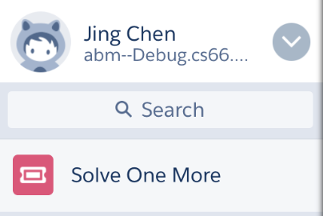
SOM App in Salesforce
You must be set up with the app first.
Click the to access the Solve One More App.
Notes:
ASK the group if they have successfully installed the mobile app per the instructions sent in the meeting invite.
If a significant number of people haven’t installed it yet, it’s a good idea to take a few minutes to do it now in this meeting.

Slide 25
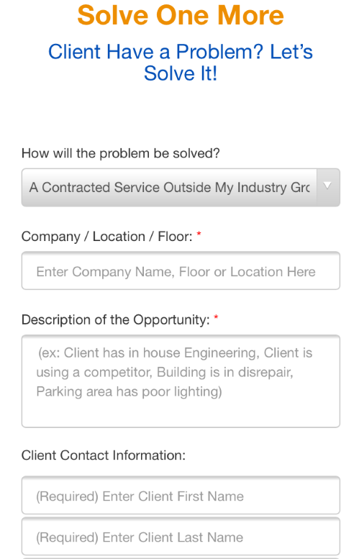
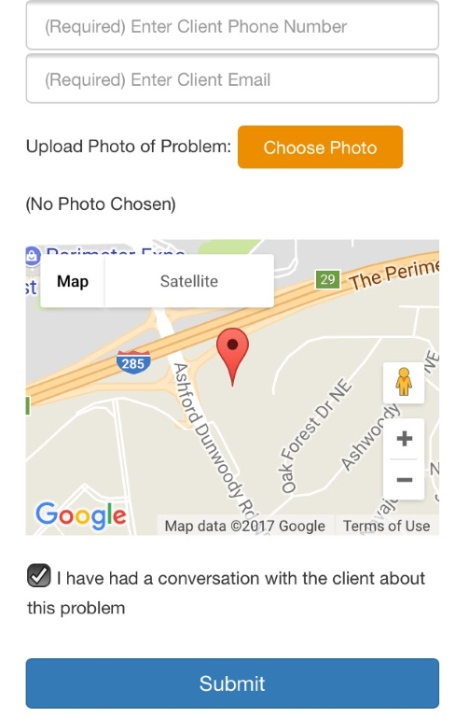
SOM App in Salesforce
Notes:
Walk through entering an opportunity via the mobile app

Slide 26
Following Up on Opportunities
Acknowledge receipt
Lead Source: SOM
Update: Activity or Status
Work as a team ☺
No activity/status in 30 days = Notice
Notes:
Following Up on Opportunities (5 minutes)
Opportunities in Salesforce.com will have lead source of Solve One More
Acknowledge the receipt of the lead by updating the status or activity
Work as a team with the person that submitted the opportunity. Contact them for additional information, to make an introduction, etc.
If there is no activity against the Opportunity logged into Salesforce.com for 30 days, the system will generate a notice

Slide 27
Take Action!
Notes:
Ask group:
Does anyone have a client in mind that may have a need for additional services?
Open up the Action Plan spreadsheet.
Explain: Before we leave today, our goal is to complete the first 5 columns for 10-15 clients in our market.
Column 1: Target Client – who has a client where there is opportunity for ABM to provide additional services?
Column 2: What services does ABM currently provide?
Column 3: What services do you think may be an opportunity to Solve One More?
Column 4: Who is going to chat with the client to gain their interest in additional services and submit the opportunity? (and have the chance for incentive $ ☺)
Column 5: When will you commit to having the chat with the client? (in the next 2 weeks is preferable)
Once Action Plan has 10-15 clients with first 5 columns completed, return to power point presentation.

Slide 28
Next Steps
Talk to our clients, submit leads
Sales: follow up immediately
Sales: record activity in Salesforce.com
Follow up meeting in 4 weeks
Notes:
Read the next steps on the slide.
Announce that a follow up meeting will be scheduled in approximately 4 weeks from now to check on the status of our plan.
At the follow up meeting we will discuss:
Our progress on target clients and action plan
What struggles or obstacles did we encounter and what can we do to overcome them?
Where did we have success?
Identify additional target clients and update the action plan

Slide 29
Questions?
Notes:
Let group know: If you would like more information, please see the Cross Selling Resource sheet in your meeting package. It contains information on the Solve One More website, contact people, the sample scripts we covered earlier and more.

